Slide 1
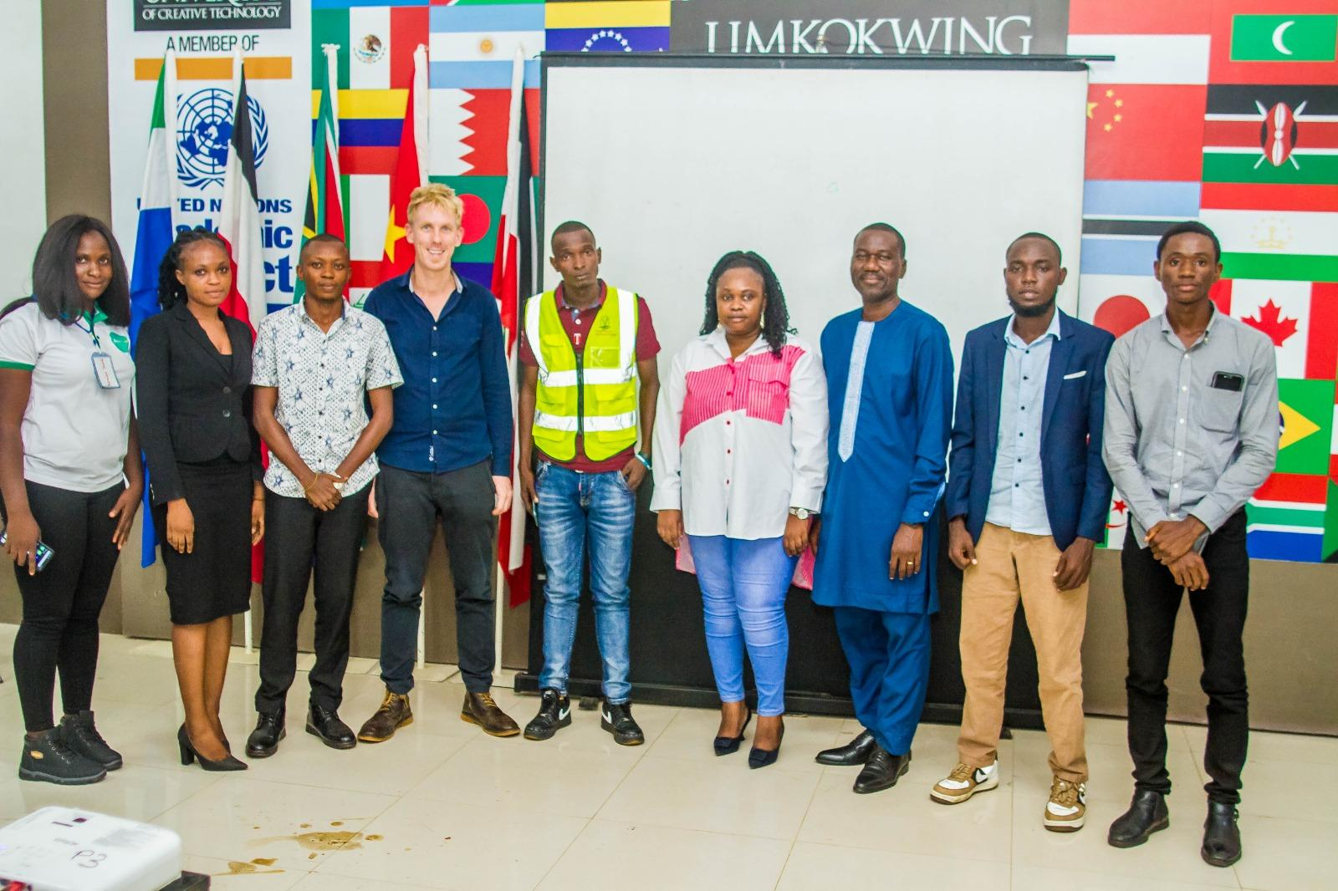
Entrepreneurship is for everyone'..

Slide 2


Freetown Pitch Night Theme: AI for Agriculture
FarmWise: Specialized AI for all farmers and aspiring farmers

Slide 3

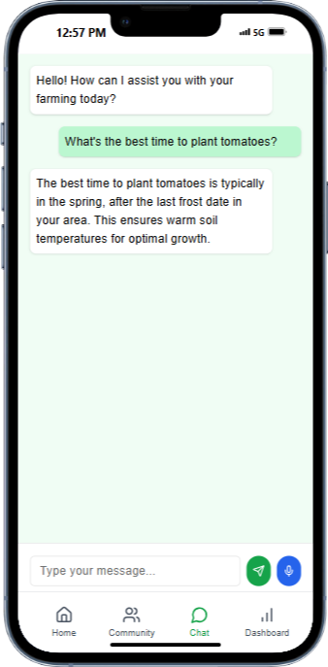
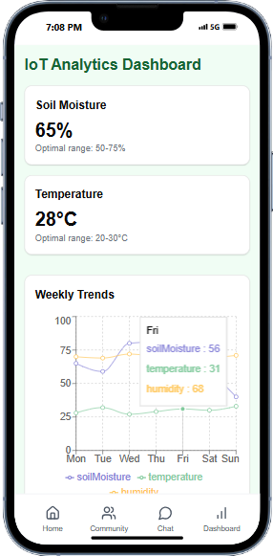
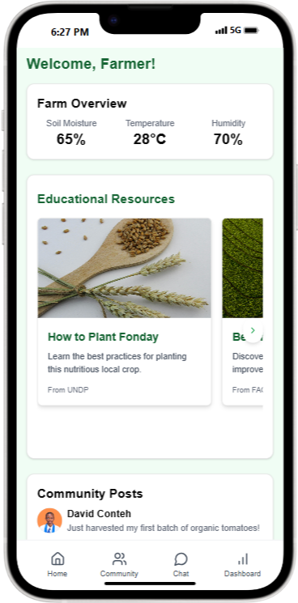
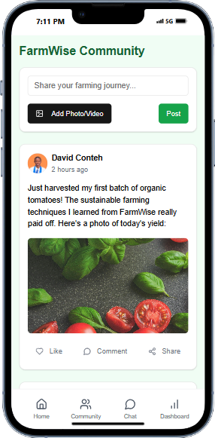
What to Plant? When to Plant? How to Plant?

Slide 4
Problem Statement
Insufficient localized tools for education and
sustainable farming.
Lack of access to timely and accurate agricultural information.
Limited use of technology in small-scale farming to optimize yields and reduce waste.

Slide 5
Our Solution
AI Powered Recommendations
IoT Integration
FarmWise Community
Tailored, localized educational tools with AI chatbot and voice assistance
Real-time soil monitoring and precision farming tools
A space for farmers and aspiring farmers to connect, offer help and share knowledge to sustainable agricultural practices.

Slide 6
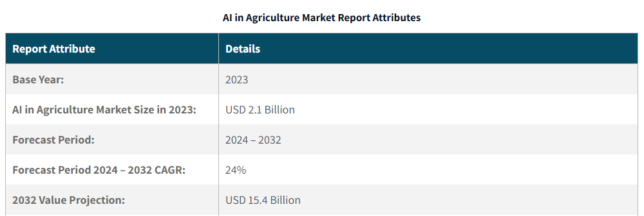
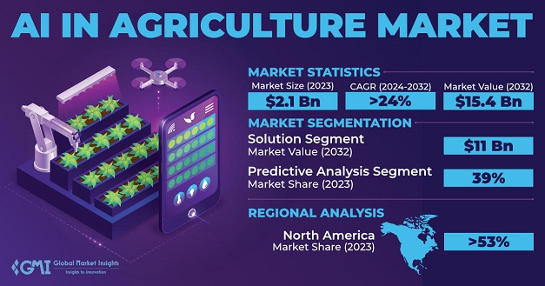
Market Opportunity
The Growing Demand for Sustainable Solutions
The demand for sustainable solutions is growing at an exponential rate because we all want to live in a safer and cleaner world.
"Market Potential in Sustainability and AI“
Artificial Intelligence is revolutionizing sustainable solutions by democratizing innovation.
“Data-Driven Agriculture“
The value of agricultural data is rising as farmers seek insights to improve productivity.

Slide 7
Technology Overview
" Our AI Platform“
Mobile App
Website
IoT Device
“Education is the most powerful weapon
which you can use to change the world.”
– Nelson Mandela

Slide 8
Key Features and Benefits
AI-driven mentorship personalized for individual farming needs.
IoT-powered precision tools for real-time soil and crop monitoring.
Voice-assisted agents for seamless access to agricultural knowledge in local languages.
A space for farmers to connect, share knowledge and insight to sustainable agricultural practices and document their journeys.
Voice-assisted agents for seamless access to agricultural knowledge in local languages.

Slide 9
Key Features and Benefits
AI-driven mentorship personalized for individual farming needs.
Voice-assisted agents for seamless access to agricultural knowledge in local languages.
IoT-powered precision tools for real-time soil and crop monitoring.
Partnering with UN-WFP, FAO, MAFFS and other organizations to give inclusive and localize guides on farming and sustainable practices.

Slide 10
Use Cases
Plot Suitability Assessment with AI Image Analysis
Personalized Crop Learning and Community Support
Soil Quality Testing with AI Analysis
Pest and Disease Detection with AI Image Recognition
Crop Calendar and Weather Forecast Integration
Voice-Based Agricultural Support for Non-Literate Users
Community Knowledge Sharing
Smart Fertilizer Recommendations

Slide 11
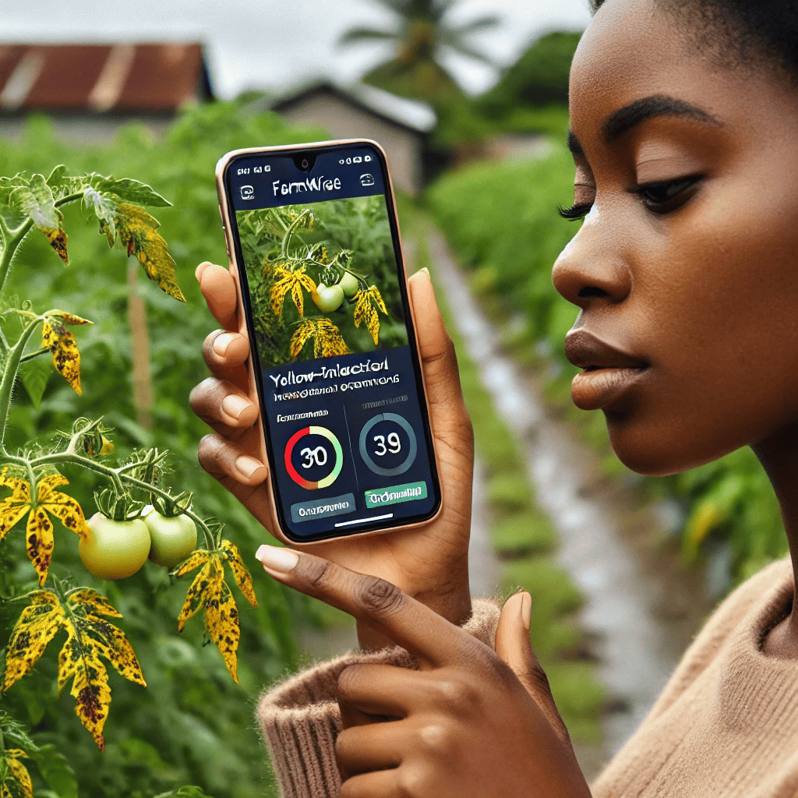
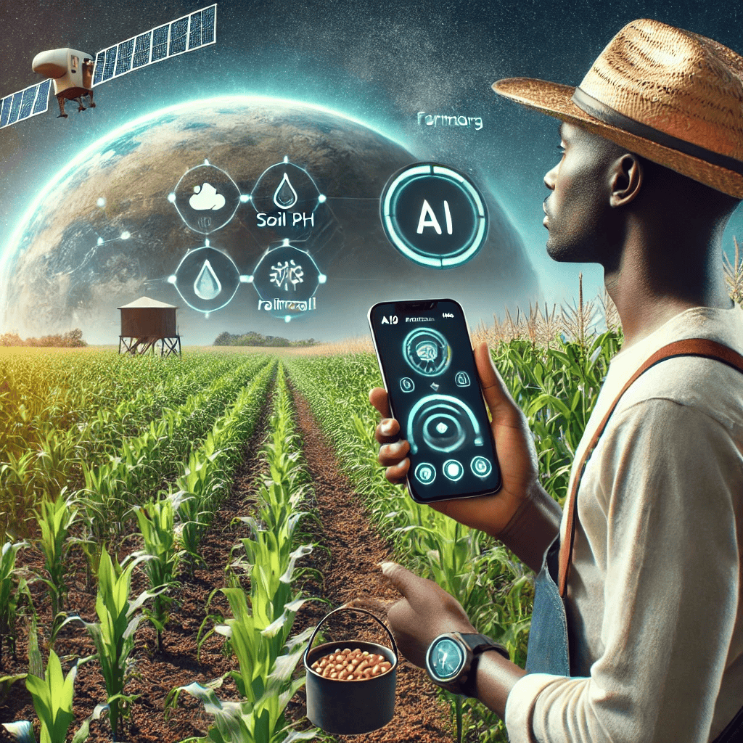
How it Works

Slide 12
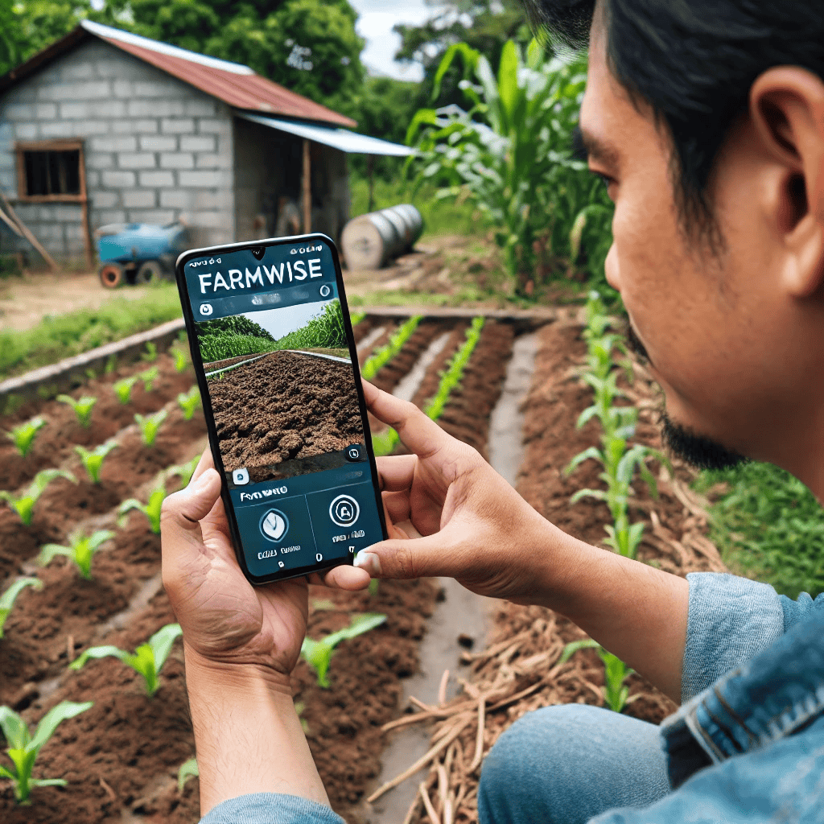
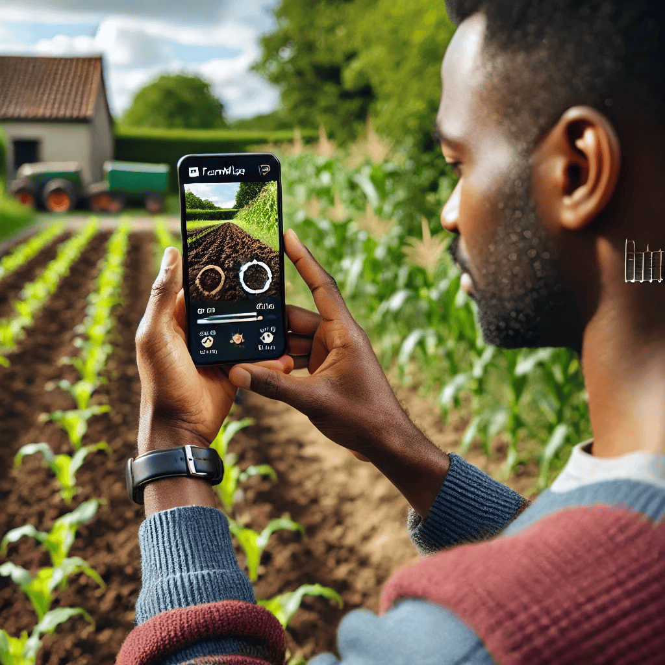
How it Works

Slide 13
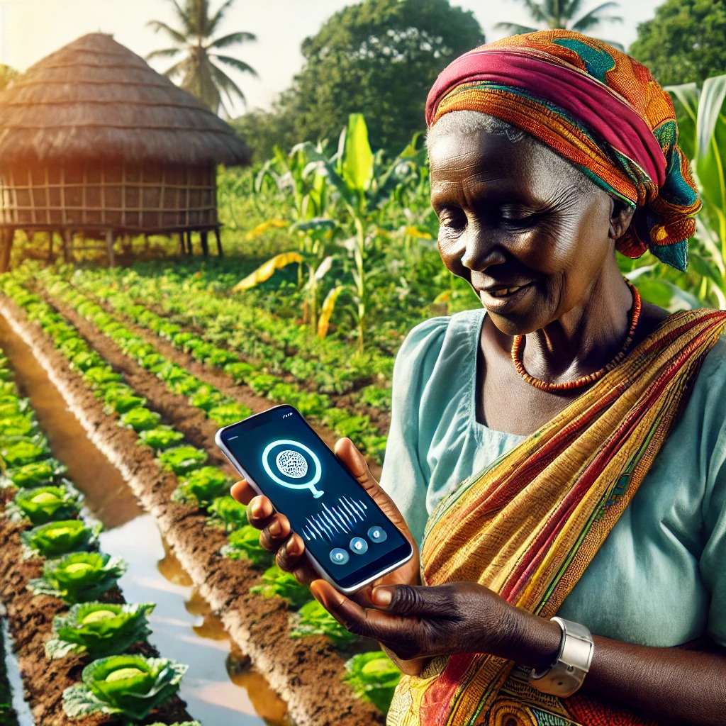
How it Works
Download the app
Talk with the Krio speaking voice assistant agent
Get instant recommendations and modern farming techniques without the literacy barrier.

Slide 14
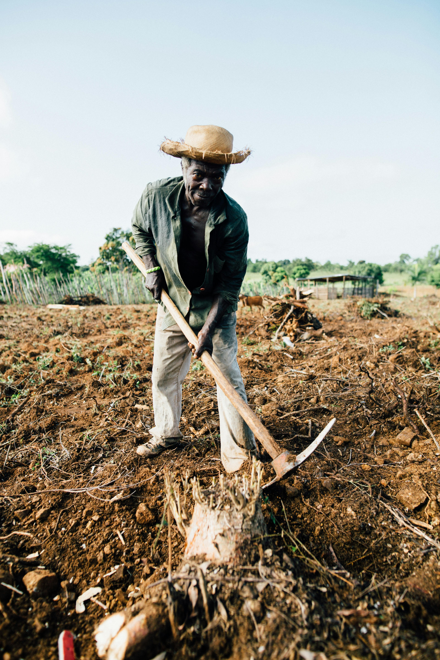
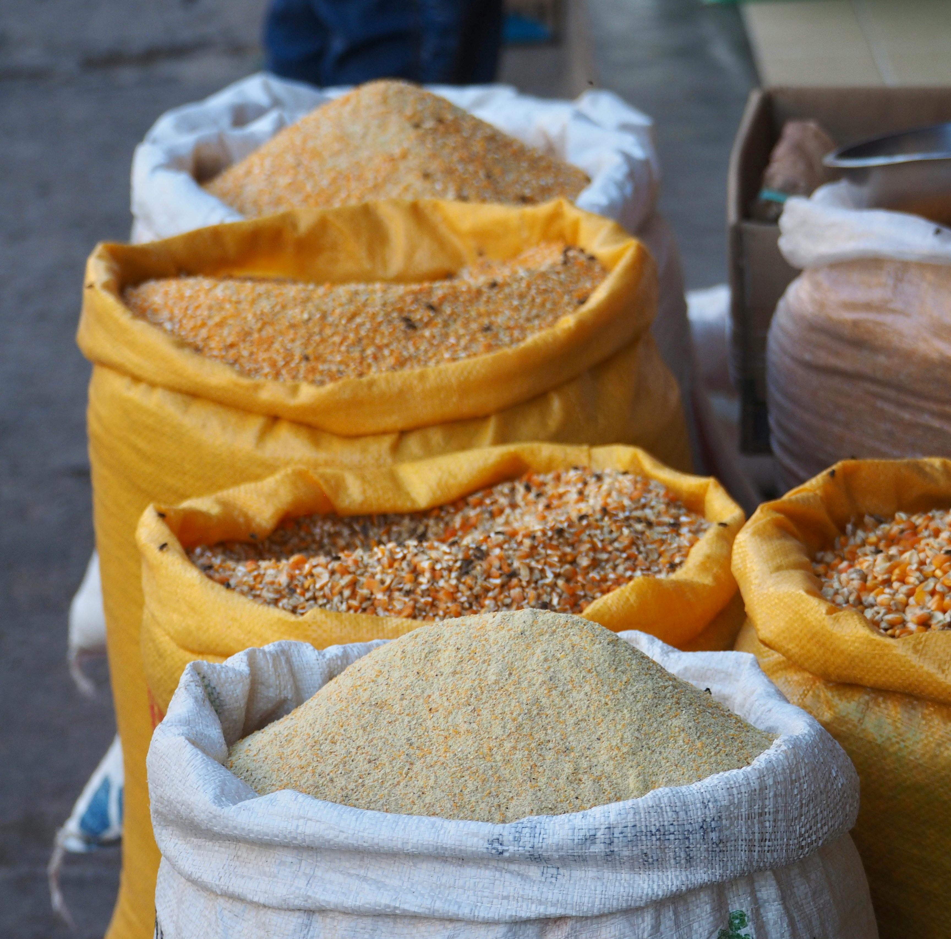
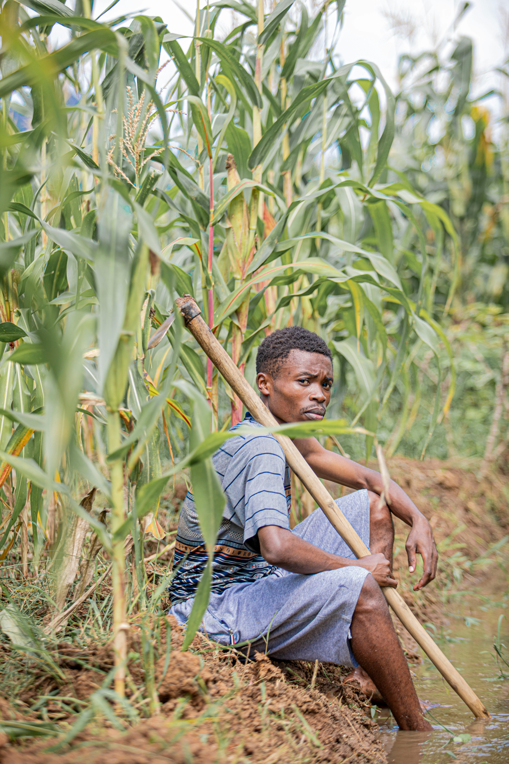
Impact
By 2030, FarmWise aims to:
● Train over 1 million farmers globally through its AI-powered education tools.
● Reduce agricultural waste by 30% in communities it serves.
● Promote sustainable farming practices in every part of SierraLeone.
Job Creation
Train 1 Million Farmers
Reduce agricultural waste by 30%
Job creation for 100 Youths

Slide 15

Competitive Advantage
Localized and Inclusive Solutions
Real-time AI-Driven Insights specific to farmers environment
Comprehensive Platform
Personalized Curriculum
Focus on sustainability
Features | FarmWise | Competitors
Localized & Inclusive Solutions
Affordable & Scalable Model
AI-Powered Precision Farming
Sustainability-Driven Approach
Community & Data-Driven Insights

Slide 16
Business Model
Premium IoT Solutions
Data Analytics and Insights
21Days Free Trial
Enterprise Solution
Educational Content Sponsorship

Slide 17
Traction & Milestone
Website Launch https://farmwise.davidconteh.engineer
Mobile App Development
Product Validation with 4 farmers so far.
Website Launch
Mobile App Development
Product Validation With 4 Farmers so far

Slide 18
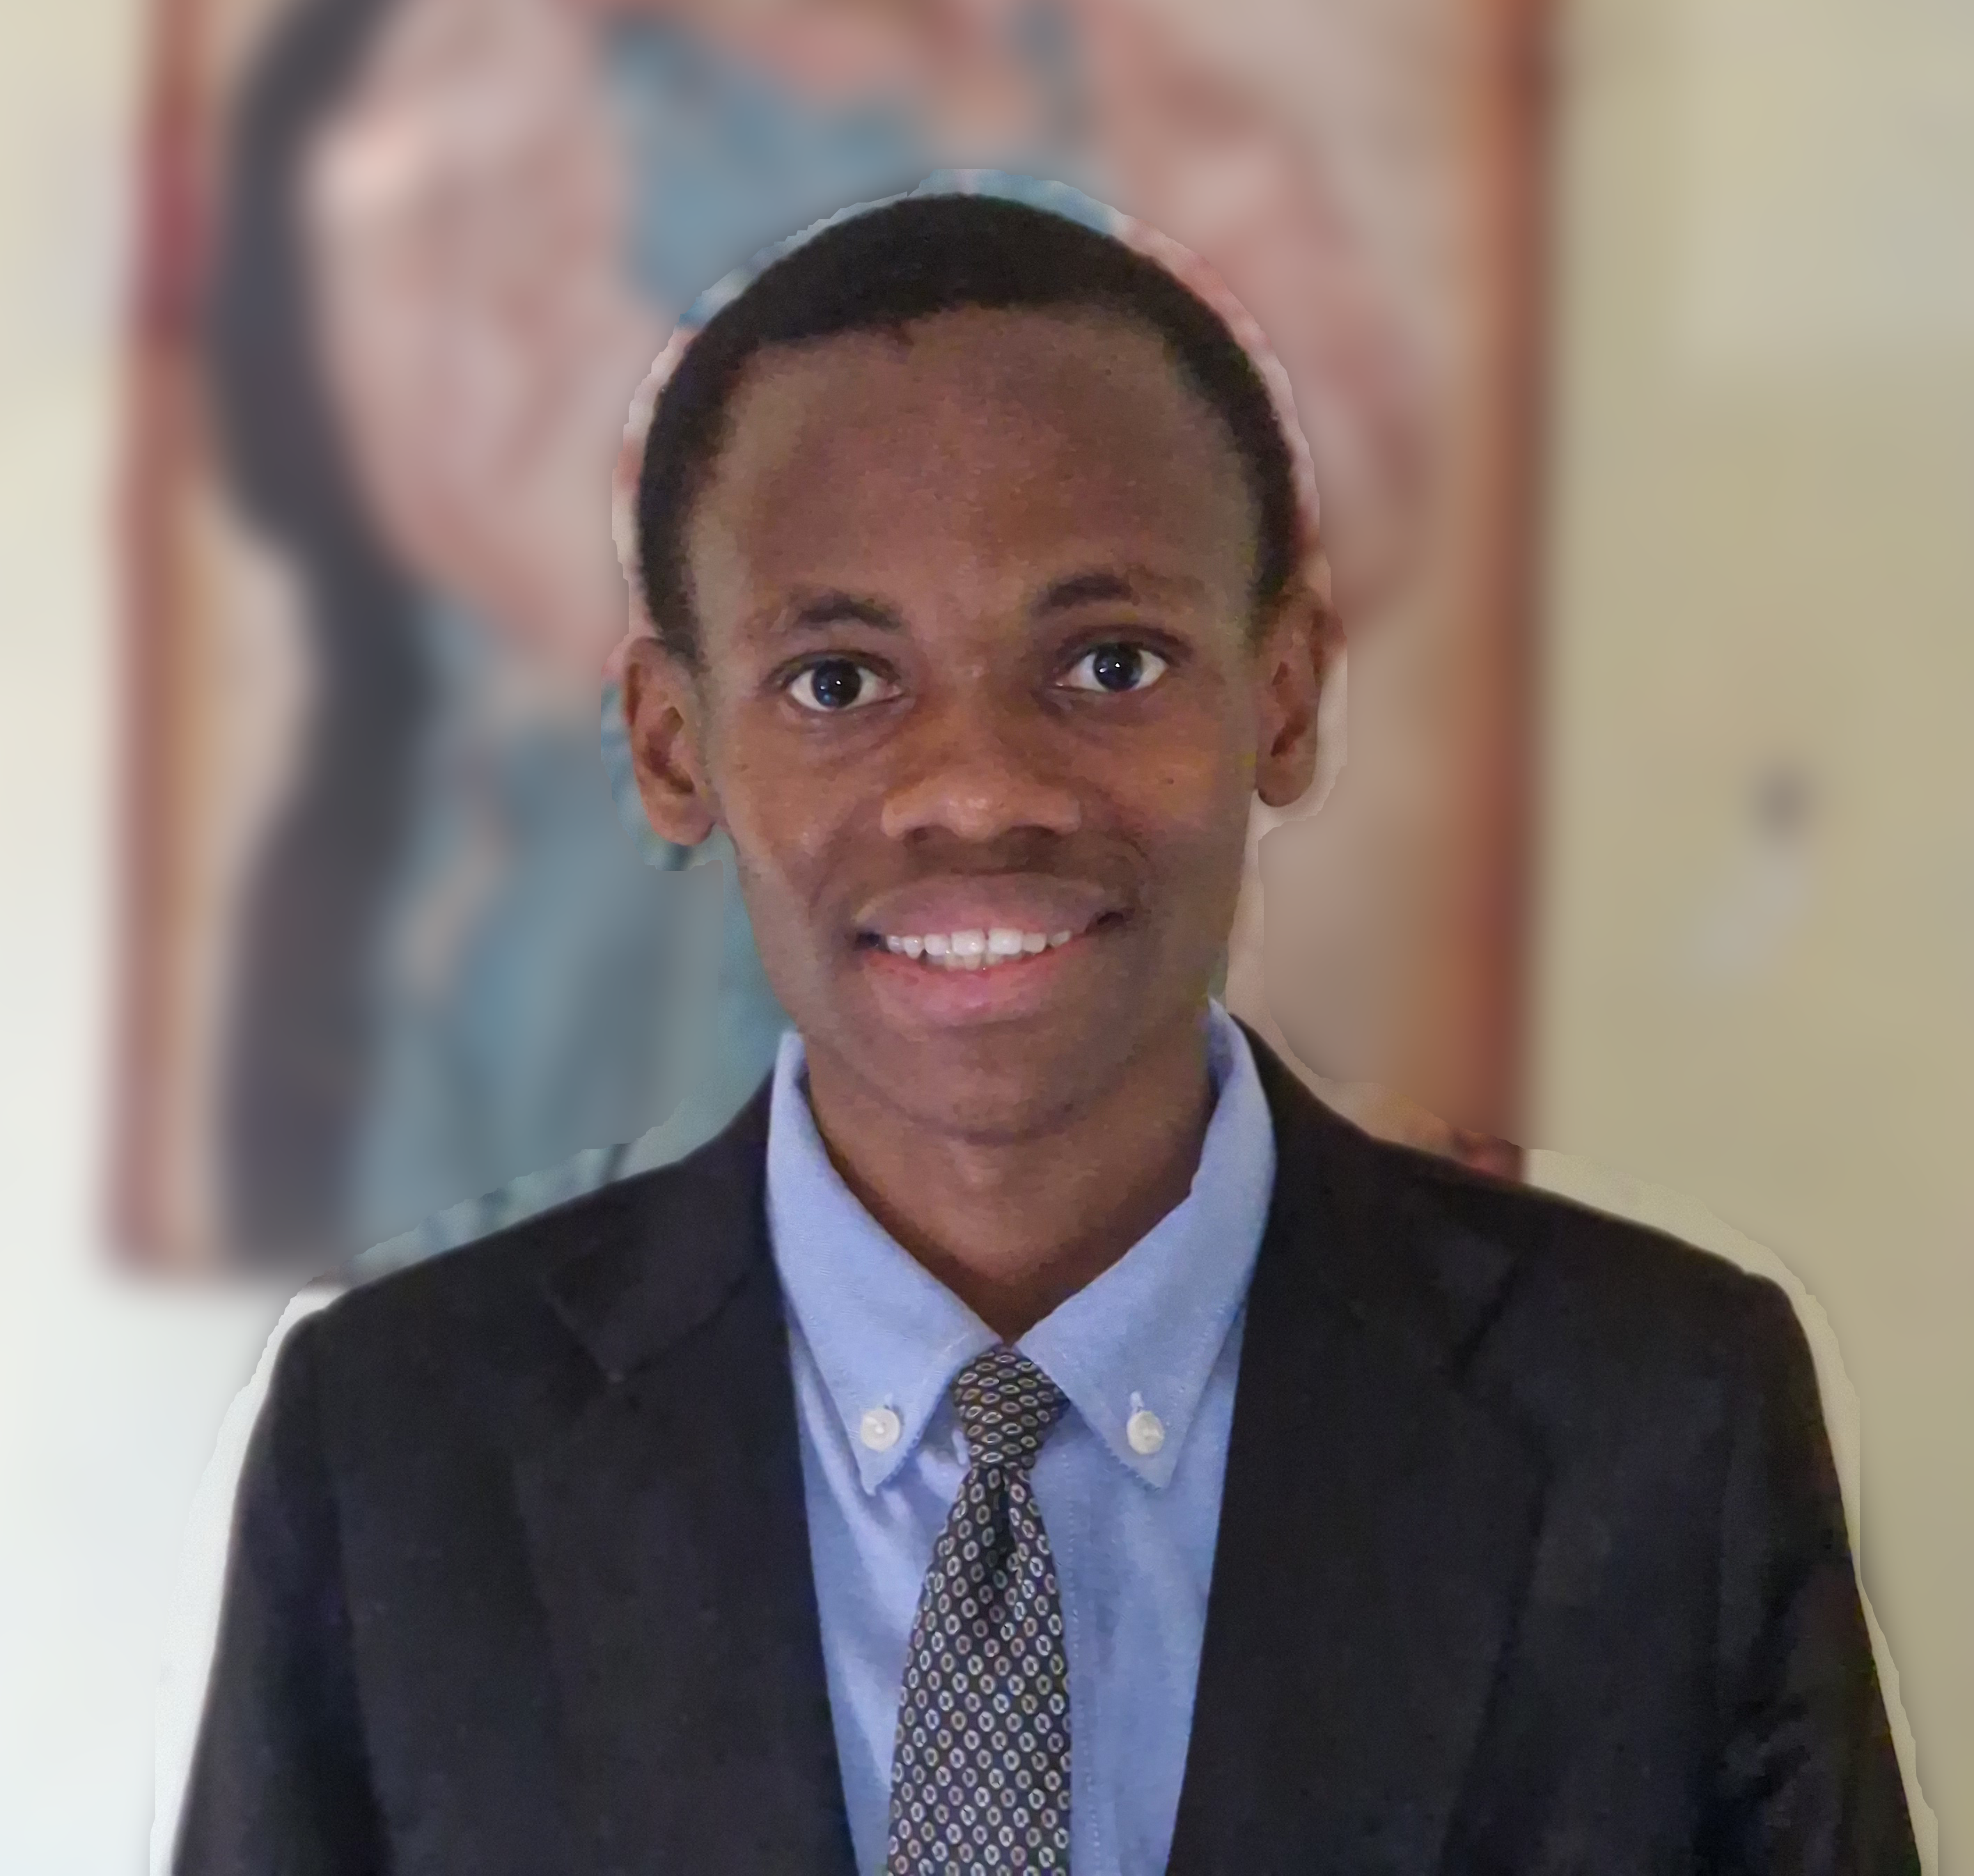

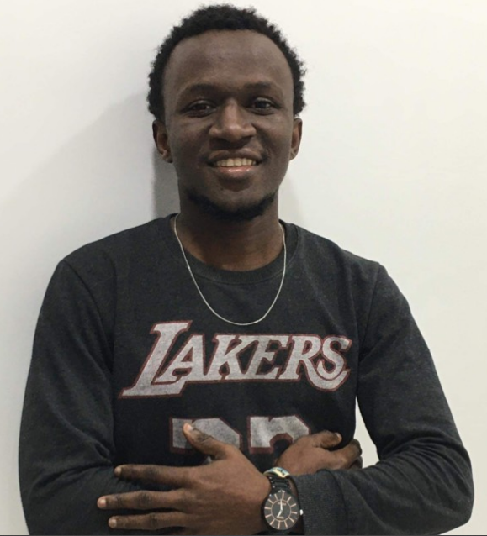
Team
The Minds Behind the Mission
David Conteh Founder & CEO
Lukman Aufbau
COO
Maada Mansaray CTO

Slide 19
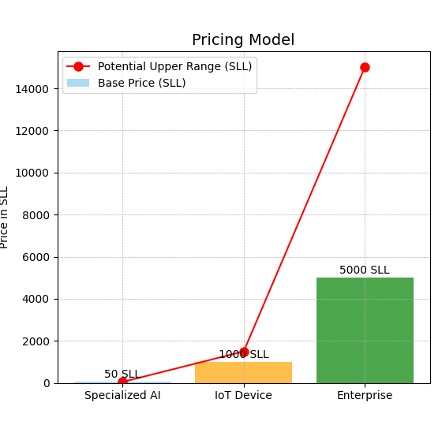
Financial Projections

Slide 20
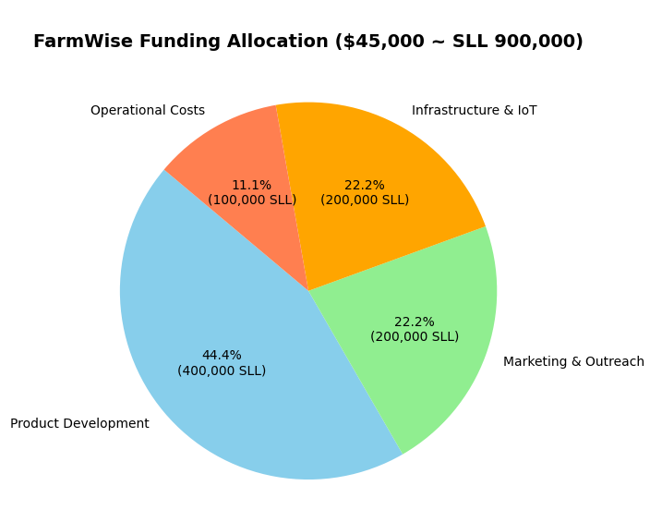
The Ask
Be part of the FarmWise movement to transform agriculture through education while promoting sustainability. Whether you’re a farmer, educator, or sustainability advocate, your participation is key.
Together, we can build a smarter, greener future.

Slide 21


Entrepreneurship is for everyone'..

